Slide 1
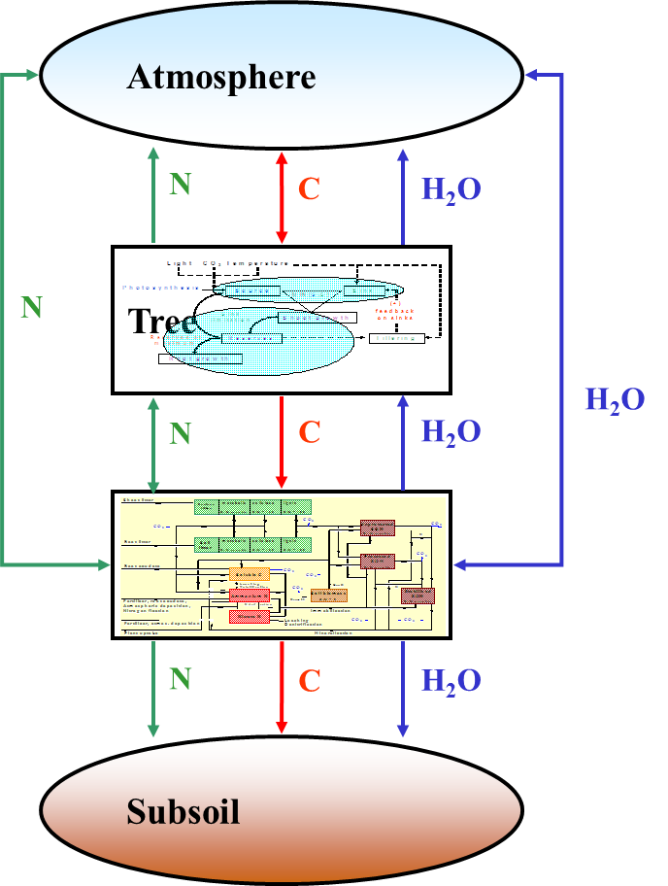
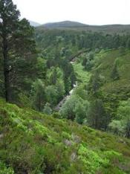
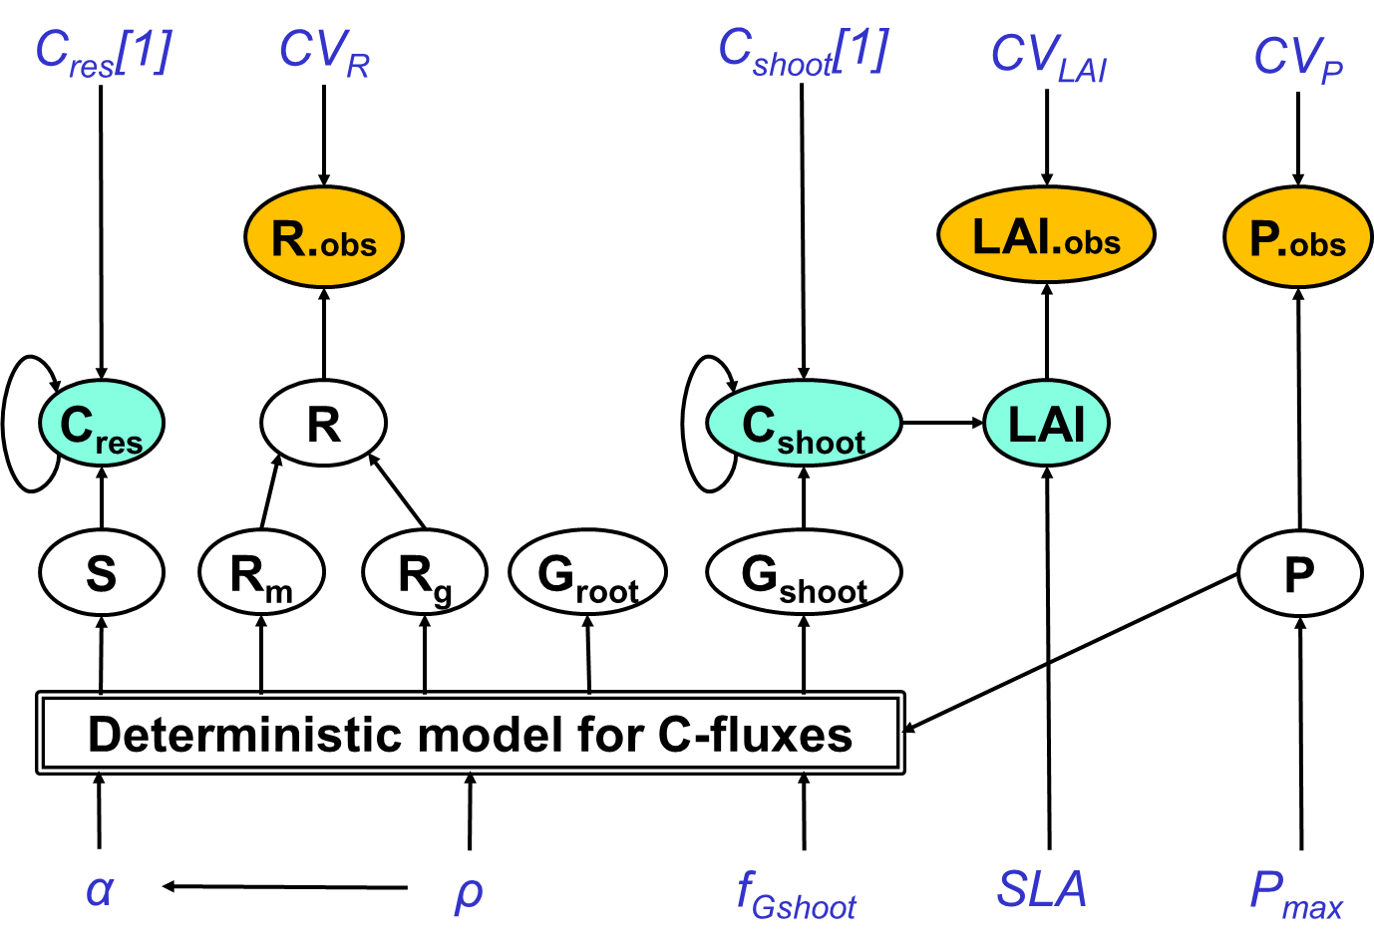
Bayesian Methods for Ecological and Environmental Modelling: INTRODUCTION
Marcel van Oijen, Lindsay Banin, David Cameron, Peter Levy, Kate Searle
CEH-Edinburgh, 2019-09-09

Slide 2
Agenda
Date |  | What | Who | Software introduced
Every day | 9-9:15 | Coffee & Tea (Room 75)
 | 11-11:15 | Coffee & Tea (Room 75)
 | 13-14 | Lunch (Pentland Link) - not on Friday
 | 15:30-15:45 | Coffee & Tea (Room 75)
Mon 9 Sep. | 14-17 | Self-introductions by all, Bayesian basics, Overview of the course | MvO | R, Rstudio, Rmd
Tue 10 Sep. | 9:15-9:30 | Questions regarding yesterday? | MvO
 | 9:30-13 | Hierarchical modelling, Graphical modelling | KS | JAGS
 | 14-17 | Spatial modelling | LB | geoR
Wed 11 Sep. | 9:15-9:30 | Questions regarding yesterday? | KS & LB
 | 9:30-13 | Combining diverse datasets | PL | rstanarm
 | 14-17 | Comprehensive uncertainty quantification, Emulation | DC | Process-based modelling, BayesianTools
Thu 12 Sep. | 9:15-9:30 | Questions regarding yesterday? | PL & DC
 | 9:30-11 | Spatio-temporal modelling | LB | R-INLA
 | 11-13 | Model comparison & evaluation | MvO
 | 14-15 | Diagnosing model weaknesses | MvO
 | 15-17 | Communication of results | MvO | ggplot2 (PL), R-Shiny (DC)
Fri 13 Sep. | 9:15-9:30 | Questions regarding yesterday? | MvO
 | 9:30-13 | Software alternatives, Future use of Bayesian methodology, Group discussion | MvO

Slide 3
Course philosophy
Understand methods, rather than use as a black-box
Discern underlying simplicity in equations, statistics, papers ...
Design your own statistical model, rather than taking one from the shelf
Know how to implement your statistical model in existing software ...
... but be able to write Bayesian algorithms from scratch too
Open-Access: https://github.com/NERC-CEH/BayesCourse

Slide 4
Contents
Models and uncertainty
The Bayesian approach
Markov Chain Monte Carlo sampling (MCMC)
EXAMPLE: Bayesian Calibration (BC) of forest model BASFOR
The Bayesian tower of Babel
Projects at CEH that use probability theory
Likelihood function L(θ) = P(D|θ)
Summary
This week's course programme
Reading mathematical notation

Slide 5
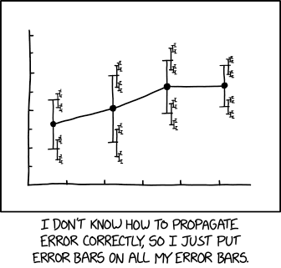
1. Models and uncertainty

Slide 6
1.1 Process-based models (PBM)
Atmosphere
N
C
H₂O
Tree
N
H₂O
N
C
H₂O
Soil
N
C
H₂O
PBM = “Process-based model”
Subsoil

Slide 7
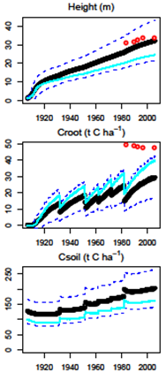
1.2 I/O of PBMs
Atmospheric drivers
Parameters & initial constants vegetation
Parameters & initial constants soil
Simulation of time series of plant and soil variables
Management & land use
Input
Model
Output

Slide 8
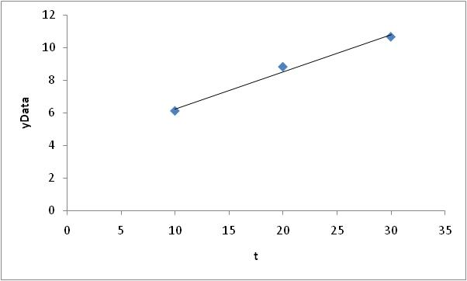
1.3 I/O of empirical models
Two parameters:
P1 = slope
P2 = intercept
One variable:
t = time
Y = P1 + P2 * t
Input
Model
Output
Notes:
Thesearenotes!!!

Slide 9
1.4 PBMs and uncertainty
Model
[Levy et al, 2004]

Slide 10
1.4 PBMs and uncertainty
bgc
century
hybrid
N_{dep}UE (kg C kg⁻¹ N)
[Levy et al, 2004]

Slide 11
1.5 Variability, Error, Uncertainty
Variability is a property of a set of values: how much they differ
When we have three very precise measurements: {11 m.,12 m.,13 m.}, there is no uncertainty, but there is variability, for which a measure could be the sample standard deviation (1 m).
Error is a property of an estimate: how much it deviates from the true value
When we say "2 x 2 = 3", the error is equal to 1.
Uncertainty is a property of our state of knowledge: the extent to which it is incomplete
When we say "This tree has a height of about 12 m.", the exact height is uncertain, so the error magnitude is uncertain too.
Statistics (including Bayesian statistics) is primarily the study of uncertainty.

Slide 12
1.6 There are many models!
Status: 681 models (11.03.2011)
http://ecobas.org/www-server/index.html
ACRU; Agricultural Catchments Research Unit Model
AMORPHYS: A forest model based on tree morphology and physiology
AREFS: The Automated Regional Ecological Forecast System
BIOMASS: Forest canopy carbon and water balance model
BROOK: BROOK, BROOK2 and BROOK90
BWIN: Program for forest stand analysis and prognosis
CACTOS: California Conifer Timber Output Simulator
CALPRO: The growth model for uneven-aged mixed conifer stands in California
CARDYN: CARbon DYNamics
CARRY: CARRY - contaminant transport model
CRYPTOS: CRYPTOS
CUPID: A comprehensive model of plant-environment interaction
DENIT: DenNit
DRYADES: Dryades
DYNLAYER: Dynamic forest simulator
EFIMOD: Dynamic Model of the "Mixed Stand/Soil" System in European Boreal Forests
EFISCEN: European Forest Information Model
(…)

Slide 13
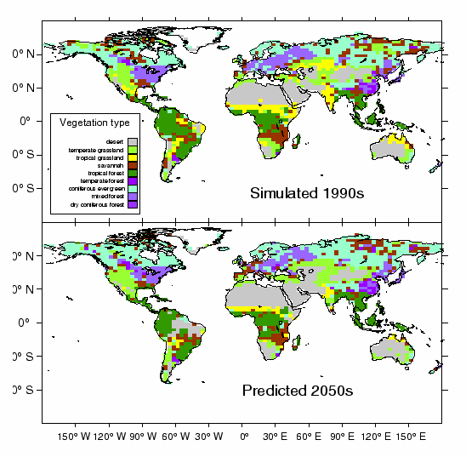
1.7 Coupled vegetation-climate modelling
Death of Amazonian rain forest ?!
White et al (1998)

Slide 14
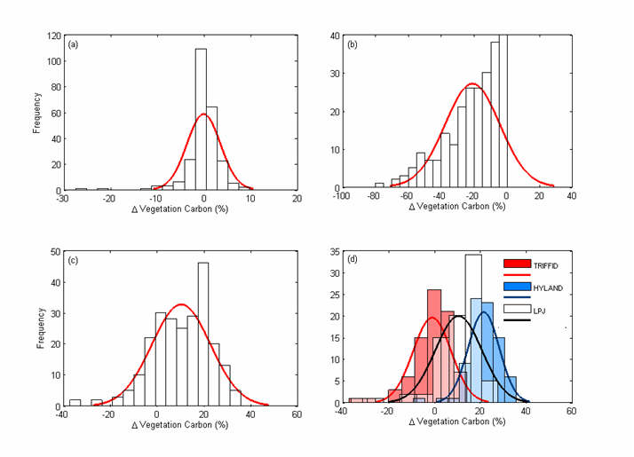
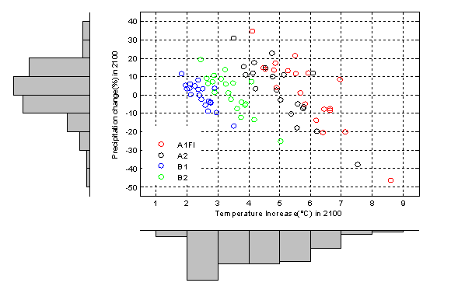
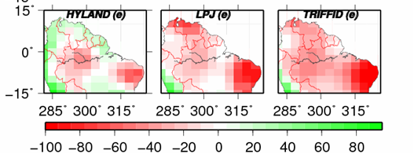
1.8 Amazonia’s future: model uncertainties
1. Change in precipitation and temperature
over Amazonia predicted by 20 GCMs
3. Resulting change in rainforest biomass predicted
by 3 vegetation models x 20 GCMs x 4 scenarios
2. Change in rainforest biomass predicted by 3 vegetation models for most extreme scenario (HadCM3 climate, A1FI)
Galbraith et al. (2010)
%
Notes:
Climate predictions for the Amazon vary widely
Uncertainty in the response of rainforest to climate change (ie differences between models) is similarly large
Map shows % change in biomass for the most extreme (hottest, & driest) scenario

Slide 15
1.9 Uncertainty
In every modelling study:
Model parameters, inputs and structure are uncertain
How to deal with uncertainties optimally?

Slide 16
1.10 Probability Theory
Uncertainties are everywhere: Models (environmental inputs, parameters, structure), Data
Uncertainties of quantities can always be expressed as probability distributions (pdf’s)
We need methods that:
Quantify uncertainties
Show how to reduce them
Efficiently transfer information: data → models → model application
Calculating with uncertainties (pdf’s) = Probability Theory (PT)
Main tool from PT that we will use: Bayes' Theorem

Slide 17
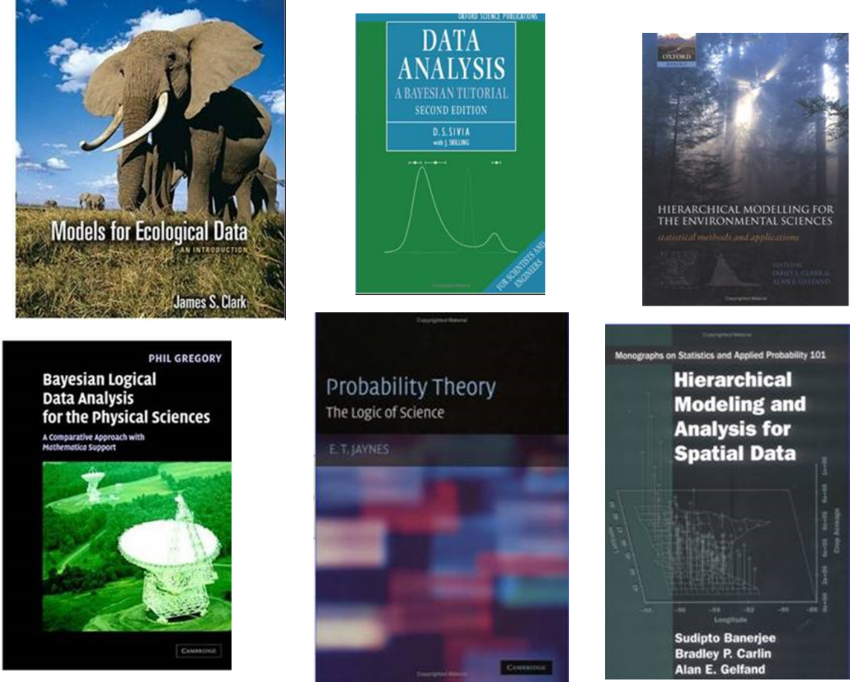
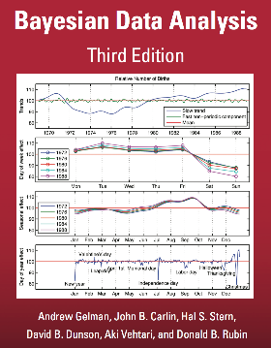

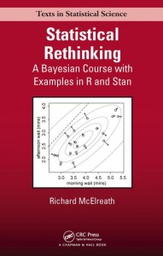
2. The Bayesian approach

Slide 18

2.1: Dealing with uncertainty: Medical diagnostics
A flu epidemic occurs: one percent of people is ill
P(dis) = 0.01
Diagnostic test, 99% reliable
P(pos|dis) = 0.99
P(pos|hlth) = 0.01
Bayes’ Theorem
Test result is positive (bad news!)
What is P(diseased|test positive)?
0.50
0.98
0.99
P(dis|pos) = P(pos|dis) P(dis) / P(pos)

Slide 19
2.1: Dealing with uncertainty: Medical diagnostics
A flu epidemic occurs: one percent of people is ill
P(dis) = 0.01
Diagnostic test, 99% reliable
P(pos|dis) = 0.99
P(pos|hlth) = 0.01
Bayes’ Theorem
Test result is positive (bad news!)
What is P(diseased|test positive)?
0.50
0.98
0.99
P(dis|pos) = P(pos|dis) P(dis) / P(pos)
= P(pos|dis) P(dis)
P(pos|dis) P(dis) + P(pos|hlth) P(hlth)

Slide 20
2.1: Dealing with uncertainty: Medical diagnostics
A flu epidemic occurs: one percent of people is ill
P(dis) = 0.01
Diagnostic test, 99% reliable
P(pos|dis) = 0.99
P(pos|hlth) = 0.01
Bayes’ Theorem
Test result is positive (bad news!)
What is P(diseased|test positive)?
0.50
0.98
0.99
P(dis|pos) = P(pos|dis) P(dis) / P(pos)
= P(pos|dis) P(dis)
P(pos|dis) P(dis) + P(pos|hlth) P(hlth)
= 0.99 0.01
0.99 0.01 + 0.01 0.99
= 0.50

Slide 21
2.2 Using data to reduce model uncertainties
Prior Information from model
Model uncertainty
μ_{M}
X = CO₂-emission rate (gC m⁻² d⁻¹)

Slide 22
2.2 Using data to reduce model uncertainties
Prior Information from model
New Information from data
σ_{D}
Uncertainty about measurement error
σ_{M}
Model uncertainty
μ_{M}
μ_{D}
X = CO₂-emission rate (gC m⁻² d⁻¹)

Slide 23
2.2 Using data to reduce model uncertainties
Posterior estimate
μ’=μ_{M}+W(μ_{D}–μ_{M})
σ’²=Wσ_{D}²
W=σ_{M}² /(σ_{M}²+σ_{D}²)
X = CO₂-emission rate (gC m⁻² d⁻¹)
How to combine probability distributions?
Bayes Theorem: Posterior ∝ Prior × Likelihood of data
Simple example (Gaussians): analytical solution
Complex cases: numerical algorithms needed (e.g. MCMC)

Slide 24
2.3 Bayes’ Theorem (1763)
B
A
What is the value of P(A|B) ?
P(A|B) = P(A) P(B|A) / P(B)
=
1/3
5/7
1/5
/
*
3/7

Slide 25
2.4 The likelihood function L(ϑ) = P(D|ϑ) quantifies uncertainty about error in data
MEANING HOW TO QUANTIFY SUMMARY
Uncertainty Incomplete knowledge Probability distribution Var(x)
Variation Differences between Frequency distribution Var(x)
multiple items
Error Difference from truth x – x_{true} -
If we measure something three times, we tend to get different values …
⇒ Variation between measurements
We generally do not know the true value …
⇒ Uncertainty about true value
⇒ Uncertainty about error in measurements
But we may define an ‘error model’, e.g. “We can measure D with precision ± 5%” …
⇒ Our error uncertainty has probability distribution p(e) = N[e ; μ=0, σ=0.05 D]
⇒ Our likelihood function is L(ϑ) = P(D|ϑ) = N[ e=D-f(ϑ); μ=0, σ=0.05 D]

Slide 26
2.5 Bayesian Calibration (BC)
P(D|ϑ) = Probability of getting the data D if the true value is f(ϑ). This probability is a function of the parameter values ϑ, i.e. the so-called ‘likelihood-function’.
P(ϑ) = Prior probability distribution for the parameters ϑ of model f. This represents our uncertainty about the parameter values, before seeing the data.
Prior pdf for the parameters
Likelihood of the data
Bayes’ Theorem
P(ϑ|D) = P(ϑ) P(D|ϑ) / P(D)
Scaling constant
( = ∫ P(ϑ) P(D|ϑ) d ϑ )
Posterior pdf for the parameters

Slide 27
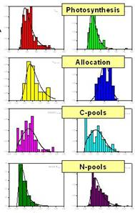
2.6 Bayesian Calibration of PBMs
Information in our data D
Prior pdf for the parameters
Likelihood of the data
Bayes’ Theorem
P(ϑ|D) = P(ϑ) P(D|ϑ) / P(D)
Scaling constant
( = ∫ P(ϑ) P(D|ϑ) d ϑ )
Posterior pdf for the parameters

Slide 28
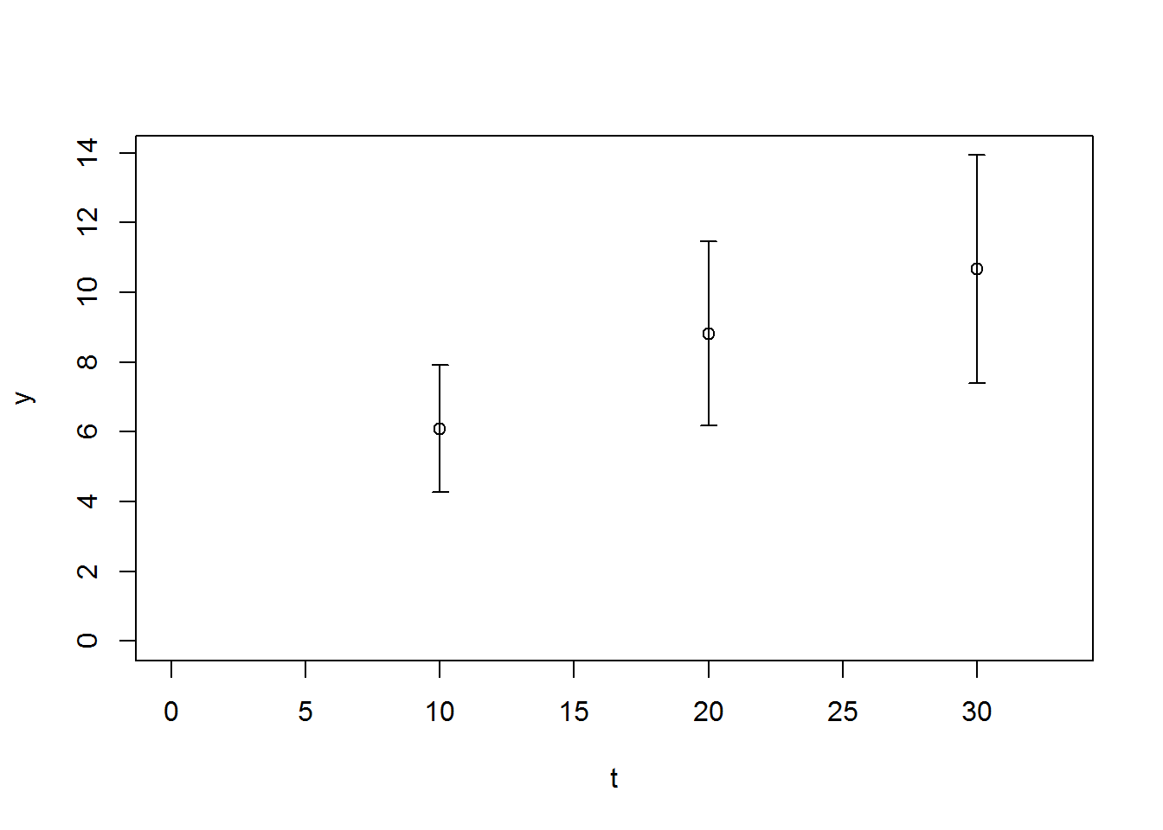
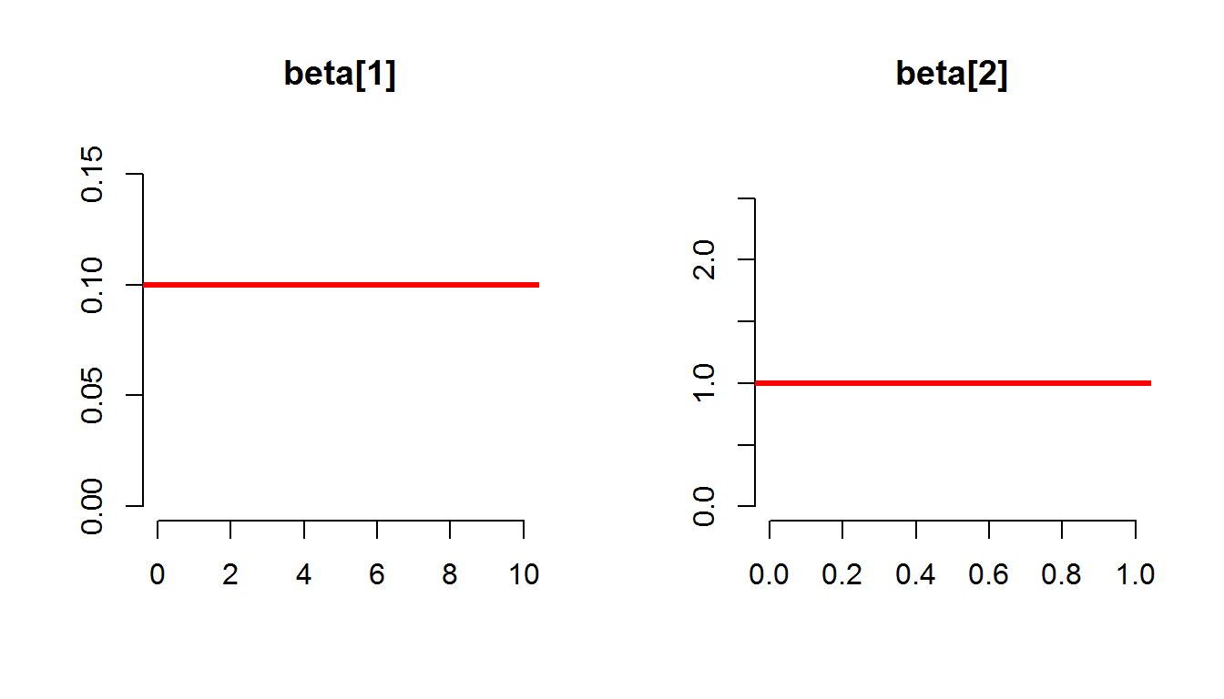
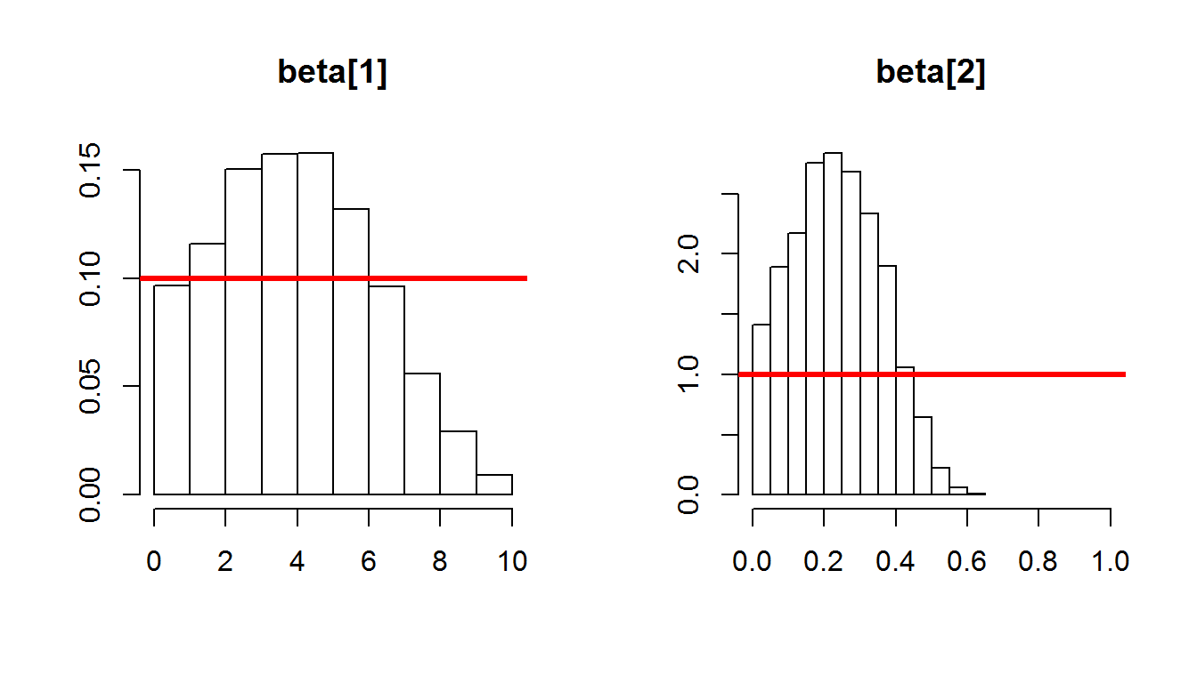
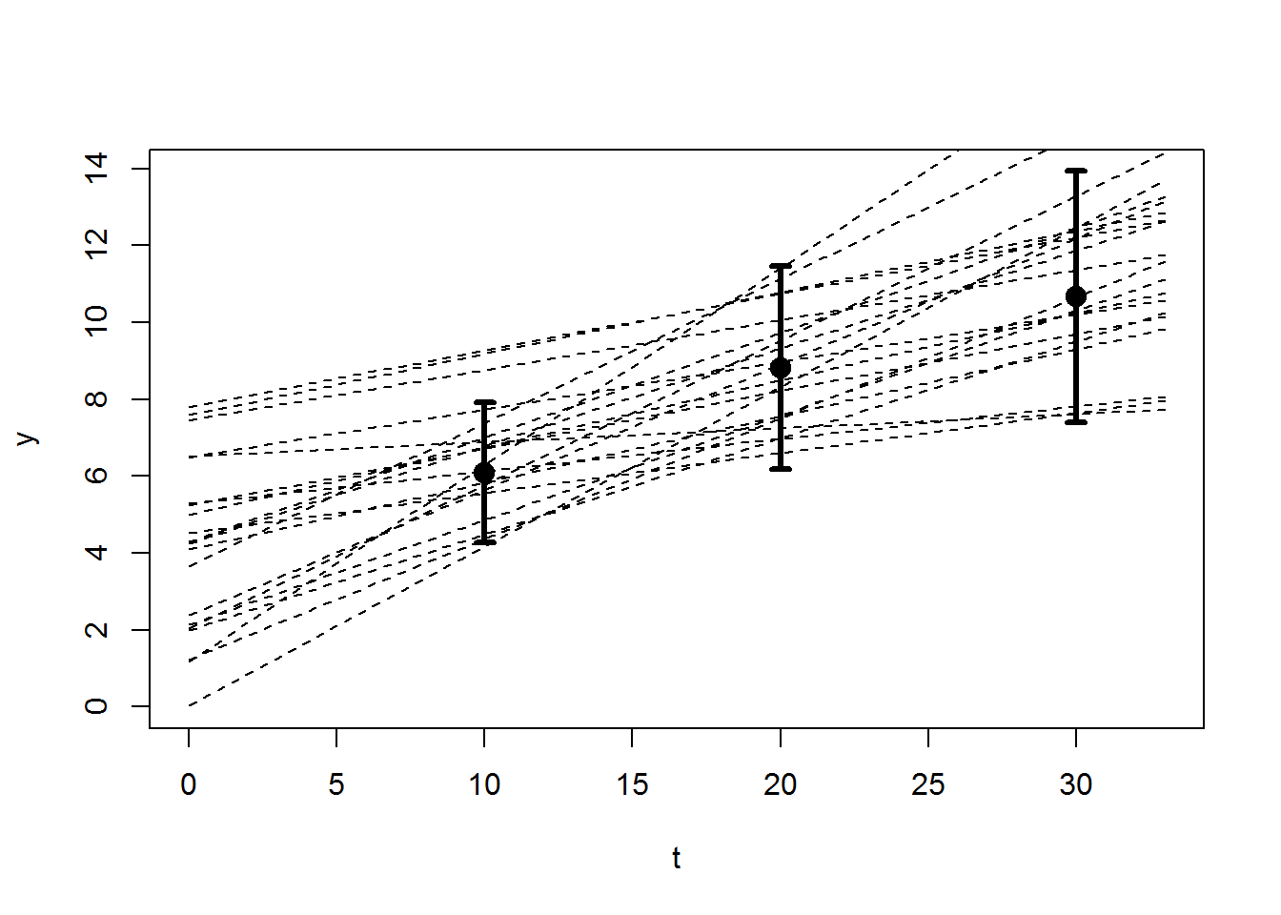
2.7 Bayesian Calibration of a regression model
Model: y(t_{i}) = θ₁ + θ₂ t_{i} + ε_{i}
Prior: P(θ) =
{ P(θ₁) = U[0,10], P(θ₂) = U[0, 1] }
y
Likelihood: P(y|θ) =
Π N( θ₁ + θ₂ t_{i} – y(t_{i}), ε_{i} )
Posterior: P(θ|y) ∝ P(θ) P(y|θ)
t
P(θ₁ | y)
P(θ₂ | y)
y
P(θ₁)
P(θ₁)
P(θ₂)
P(θ₂)
t

Slide 29
2.8 Probabilistic science: workflow
Research question
In environmental sciences …
f is often a big, slow process-based model
P(ϑ) is multivariate
D: big data
Bayesian updating requires numerical methods such as MCMC
Formulate model
y = f(x;ϑ)
Get new information
Assess information
P(ϑ)
new data (D)
Calculate
likelihood
Update probability distrib.
P(ϑ|D)
P(D|ϑ)
Apply model
Provisional answer

Slide 30
3. Markov Chain Monte Carlo sampling (MCMC)

Slide 31
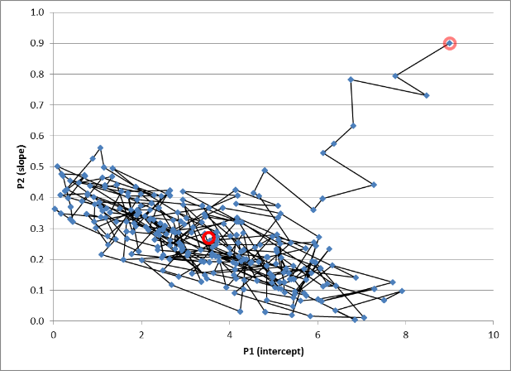
3.1 How can we calculate the posterior distribution?
We have: (1) a prior pdf P(θ) for our model’s parameters, (2) new data. We also know how to calculate the likelihood P(D|θ).
Bayes Theorem tells us that the posterior P(θ|D) is proportional to P(θ) times P(D|θ), but how do we calculate that?
Answer: we do not “calculate” a formula for P(θ|D), but we sample from it using “Markov Chain Monte Carlo” (MCMC)
Parameter 2
Parameter 1

Slide 32
3.2 Computational methods for Bayesian estimation
MCMC

Slide 33
What do you need to know to run a MCMC?
Aim:
To sample from p(x)
Required:
∀ {x₁,x₂}: be able to calculate α = p(x₁)/p(x₂)

Slide 34
What is MCMC?
MCMC = Markov Chain Monte Carlo sampling
It is a method for sampling from a probability distribution
A function p(θ) on a sampling space Θ = {θ}
p(θ) ≥ 0
∫p(θ)dθ = 1
Important application:
Θ is the parameter space of a model
p(θ) represents uncertainty about parameter values
MCMC is a subset of Monte Carlo sampling
There are direct and iterative MC sampling methods
MCMC is iterative: it builds up the sample one-by-one

Slide 35
What is MC, but not MCMC?
Example of MC that is not MCMC:
Θ is the unit square (so sampling space is 2-dimensional)
p(θ) = c > 0 within a distance 1 from the origin, and 0 outside
MC: Generate 5000 candidates uniformly within the unit square, and then throw away the ones too far from the origin
R-code:
n <- 5000
xproposed <- cbind( runif(n,0,1), runif(n,0,1) )
iaccept <- xproposed[,1]^2 + xproposed[,2]^2 < 1
x <- xproposed[iaccept,]
Problems with such non-MCMC sampling methods:
Inefficient if sampling space is high-dimensional
Run R-program

Slide 36
How does MCMC work?
We build our sample from p(θ) step-by-step. Pseudo-code for all MCMC algorithms:
Start anywhere in sampling space Θ
Random walk through Θ in such a way that the set of visited points is the desired representative sample
”Markov Chain”: random walk where the jump from θ(t) to θ(t+1) is independent of θ(0) .. θ(t-1)
Pseudo-code for the Metropolis algorithm (one of many MCMC algorithms):
1. Choose θ^{(i=0)} anywhere in sampling space Θ
2. Jump randomly to a new ”candidate” point θ’
3. Calculate the Metropolis ratio α = p(θ’) / p(θ^{(i)})
4. If α ≥ 1, accept the candidate: θ^{(i+1)} <- θ’
5. If α < 1, accept the candidate with probability α,
6. Otherwise reject the candidate: θ^{(i+1)} <- θ ^{(i)}
7. Go to step 2 unless the desired sample size is reached

Slide 37
Example of MCMC - Metropolis
Same example as before:
Θ is the unit square
p(θ) = c > 0 within a distance 1 from the origin, and 0 outside
R-code:
pratio <- function(xa,xb) { (xa[1]^2 + xa[2]^2 < 1) &&
(xa[1]>=0) && (xa[2]>=0) }
n <- 5000 ; x <- vector("list",n) ; x[[1]] <- c(0,0)
for (i in 2:n) {
xproposed <- x[[i-1]] + runif(2,-1,1)
if ( runif(1,0,1) < pratio( xproposed, x[[i-1]]) )
x[[i]] <- xproposed
else
x[[i]] <- x[[i-1]]
end }
Advantages of MCMC:
Relatively efficient if sampling space is high-dimensional
Metropolis: Only probability ratios need to be known: p(θ_{A}) / p(θ_{B})
Run R-program

Slide 38
Other examples of MCMC - Metropolis
p(x): monovariate, unknown distribution on [-Inf,Inf]
p(xa)/p(xb) = exp(xb^2-xa^2)
p(x): bivariate, unknown distribution on the real number plane
p(xa)/p(xb) = exp(xb[1]^2-xa[1]^2) * exp(xb[2]^2-xa[2]^2)
p(x): bivariate, disjoint, unknown distribution on the real number plane
p(xa)/p(xb) = (xa[1]^2 + xa[2]^2 < 1) ||
((xa[1]-2)^2 + (xa[2]-0.5)^2 < 0.5)
Run R-program
Run R-programMCMC.Rmd
Run R-program

Slide 39
Using MCMC to do Bayesian linear regression
Say we have a model y = θ₁ + θ₂ * t, but we do not know the appropriate values of θ = {θ₁, θ₂}
Uncertainty about parameters θ, expressed as P(θ) = { Uniform[0,10], Uniform[0,1] }
Say we then get some data: D(t=10) = 6.09 ± 1.83, D(t=20) = 8.81 ± 2.64, D(t=30) = 10.66 ± 3.27
Uncertainty about measurement error expressed as Gaussian distributions with mean μ=0 and standard deviations σ_{i}=1.83, 2.64, 3.27
How much have the data reduced the uncertainty about the parameters: What is P(θ|D)?
Bayes’ Theorem: P(θ|D) = P(θ) P(D|θ) / P(D)
P(θ) = “prior”, P(D|θ) = “likelihood”, P(D) = “integrated likelihood”

Slide 40
The most common likelihood function P(D|θ)
GAUSSIAN
Model-data mismatch for data-point i
P(D|ϑ) =
Measurement uncertainty for data-point i
MULTIPLICATION ⇔ information from different data-points considered uncorrelated

Slide 41
EXERCISES using R: file: 'MCMC.Rmd'
But maybe first discuss how R Markdown works ... (file 'RMarkdown.Rmd')

Slide 42
Troubleshooting
Problems:
MCMC: Chain does not converge
Posterior parameter pdf looks wrong
Posterior predictions look wrong
Solutions:
Make chain longer
Change proposal (mean step length, reflection algorithm, …)
Modify prior (include more information)
Modify likelihood function (include more information, account for representativity error, account for correlations between measurement errors)
Modify model
Modify the interpretation of the model (what outputs is it supposed to produce correctly: diurnal/daily/weekly …)

Slide 43
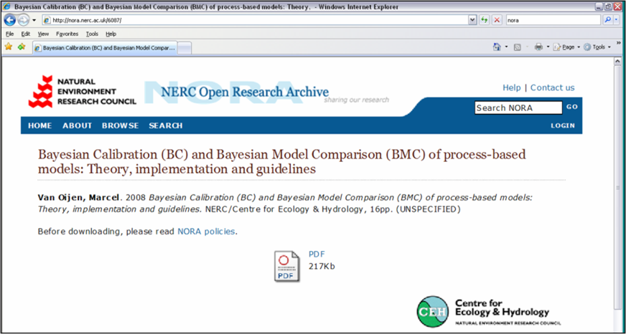
FAQ – Bayesian Calibration & MCMC

Slide 44
FAQ – Bayesian Calibration & MCMC
- Which BC algorithm should I use?
- Where can I read more about the BC methods?
- Can BC handle correlations between parameters?
- What do we do if measurement errors are not independent?
- Does it matter whether we use all data at the same time or in steps?
- The example codes are in Matlab and R: what if I work in a different programming language?
- What distribution should I use for the prior pdf?
- What is burn-in and do I need it?
- How do I make the proposal algorithm of my MCMC method more efficient?
- Is there any point in using more than one chain in MCMC?
- What do I do if the MCMC crashes?
- What do I do if the MCMC does not converge?
- What do I do if the sample from the posterior parameter pdf looks wrong, or if the posterior predictions of model output variables look wrong?

Slide 45
What you need to know about MCMC
Mixing : is it fast enough?
Burn-in : have we accounted for it?
Convergence : has our MCMC reached it?
Use of multiple chains
Example using OpenBUGS
Alternative MCMC algorithms : are they more efficient?

Slide 46
Context: How to do BC
The problem: You have: (1) a prior pdf P(θ) for your model’s parameters, (2) new data. You also know how to calculate the likelihood P(D|θ). How do you now go about using BT to calculate the posterior P(θ|D)?
Methods of using BT to calculate P(θ|D):
Analytical. Only works when the prior and likelihood are conjugate (family-related). For example if prior and likelihood are normal pdf’s, then the posterior is normal too.
Numerical. Uses sampling. Three main methods:
MCMC (e.g. Metropolis, Gibbs)
Sample directly from the posterior. Best for high-dimensional problems
Accept-Reject
Sample from the prior, then reject some using the likelihood. Best for low-dimensional problems
Model emulation followed by MCMC or A-R

Slide 47
4. EXAMPLE: Bayesian Calibration (BC) of forest model BASFOR

Slide 48
4.1 Bayesian Calibration
DATA
Prior pdf for the parameters
Likelihood of the data
Bayes’ Theorem
P(ϑ|D) = P(ϑ) P(D|ϑ) / P(D)
Scaling constant
( = ∫ P(ϑ) P(D|ϑ) d ϑ )
Posterior pdf for the parameters

Slide 49
4.2 Process-based forest model BASFOR
Environmental scenarios
Height
NPP
Initial values
Soil C
Parameters
Model

Slide 50
4.2 Process-based forest model BASFOR
40+ parameters
12+ output variables
BASFOR

Slide 51
4.3 BASFOR: outputs
Volume
(standing)
Carbon in trees
(standing + thinned)
Carbon in soil

Slide 52
4.4 BASFOR: Prior parameter uncertainty

Slide 53
4.5 BASFOR: Prior output uncertainty
Carbon in trees
(standing + thinned)
Volume
(standing)
Carbon in soil

Slide 54
4.6 Data Dodd Wood (R. Matthews, Forest Research)
Carbon in trees
(standing + thinned)
Volume
(standing)
Carbon in soil

Slide 55
4.7 Using data in Bayesian calibration of BASFOR
Prior pdf
Bayesian
calibration
Data
Posterior pdf

Slide 56
4.7 Using data in Bayesian calibration of BASFOR
Carbon in trees
(standing + thinned)
Volume
(standing)
Carbon in soil

Slide 57
4.7 Using data in Bayesian calibration of BASFOR
Prior pdf
Bayesian
calibration
Data
Posterior pdf

Slide 58
4.8 Continued calibration when new data become available
Prior pdf
Posterior pdf
Prior pdf
Bayesian
calibration
New
data

Slide 59
4.8 Continued calibration when new data become available
Prior pdf
Posterior pdf
Prior pdf
Bayesian
calibration
New
data

Slide 60
4.9 Posterior parameter correlations
39 parameters
39 parameters

Slide 61
4.10 Maps of (1) predictions, (2) uncertainties
C-sequestration (model output for 1920-2000)
Uncertainty of C-sequestration
Van Oijen & Thomson (2010) Climatic Change 103: 55-67

Slide 62
4.11 Follow-up: What kind of measurements would have reduced uncertainty the most ?

Slide 63
4.12 Prior predictive uncertainty & height-data
Height
Biomass
Prior pred. uncertainty
Height data Skogaby

Slide 64
4.13 Prior & posterior uncertainty: use of height data
Height
Biomass
Prior pred. uncertainty
Posterior uncertainty (using height data)
Height data Skogaby

Slide 65
4.14 Prior & posterior uncertainty: use of height data
Height
Biomass
Prior pred. uncertainty
Posterior uncertainty (using height data)
Height data (hypothet.)

Slide 66
4.15 Prior & posterior uncertainty: use of height data
Height
Biomass
Prior pred. uncertainty
Posterior uncertainty (using height data)
Posterior uncertainty (using precision height data)

Slide 67
5. Applications of Bayes: The tower of Babel

Slide 68
5.1 Inverse modelling

Slide 69
5.2 Bayes as a tool for learning

Slide 70
5.3 Bayesian methods in the earth system sciences
[CO₂]
General term
Specific methods
Atm. transport model
Inverse modelling
Variational methods
CO₂ – exchange rate
Ecosystem model
(Bayesian) calibration
MCMC, Rejection sampling
Vegetation characteristics, Weather
GCM, NWP
Data assimilation
Variational methods, (Extended/Ensemble) Kalman Filtering, Particle Filtering
Initial state of the atmosphere

Slide 71
More Bayes ...
Bayesian kriging
Gaussian process emulation
Hierarchical/multilevel modelling with prior
...

Slide 72
6. Projects at CEH that use probability theory

Slide 73
6.1 Site-specific vs. generic BC for European forest
RMS - ratio
RMS - ratio
Geographical distribution of NitroEurope nitrogen deposition monitoring sites. ENF: evergreen needle leaf forest; DBF: deciduous broadleaf forest
Generic BC
Site-specific BC
Cameron et al. (2018), Flechard et al. (in prep.)

Slide 74
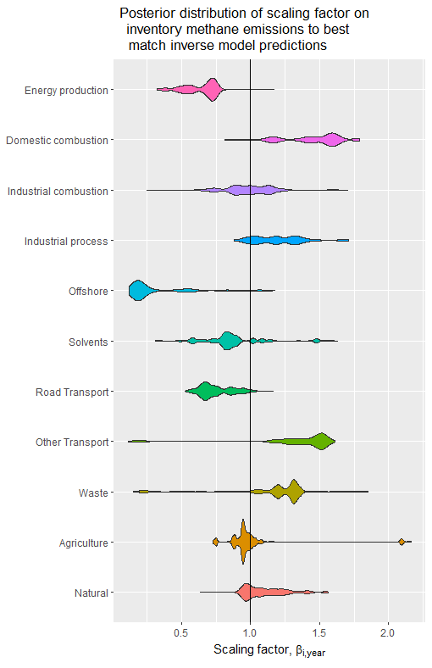
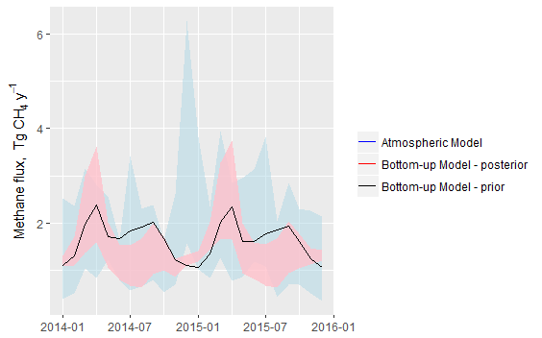
6.2 Reconciling LUC-inventory models with atmospheric inversion
Each emission sector has a characteristic spatial & temporal pattern
Use this in a Bayesian analysis of the parameters of a “bottom-up” model (anthropogenic & biogenic)
Derive sector-wise scaling factors = multipliers needed to match atmospheric model
Posterior distribution for methane shown (2014-2015)
Levy et al. (in prep.)

Slide 75
6.3 Adaptive sampling (after Wikle & Royle 1999)
Model: spatiotemporal, a combination of kriging and Kalman filter
Field: 49 potential sensor locations at each time step
Spatial and temporal correlations assumed constant and known
Design (sensor placement in space): adaptive, based on measurement history
Design criterion: put the sensor at the location that minimises the average prediction variance (i.e. the mean of the 49 kriging variances)
OPTIMAL DESIGN: Start at centre, move to other locations immediately

Slide 76

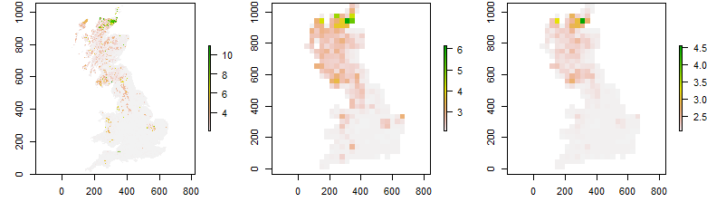
6.4 Methane model: correcting for upscaling error
Upscaling error (Δ) arises when a nonlinear model f is provided with spatially averaged input (μ_{x}), ignoring spatial variability (p(x)):
Methane (1 x 1 km)
Methane (32 x 32 km),
Output averaging (correct)
Methane (32 x 32 km),
Input averaging (incorrect)
Mean = 2.54 nmol CH₄ m⁻² s⁻¹
Mean = 2.54 nmol CH₄ m⁻² s⁻¹
Mean = 2.25 nmol CH₄ m⁻² s⁻¹ (= -12%)
This error of -12% can be reduced, while still working with averaged inputs, to -3% if we apply the Δ-formula
Van Oijen, Cameron, Levy & Preston (2017), Correcting errors from spatial upscaling of nonlinear greenhouse gas flux models

Slide 77
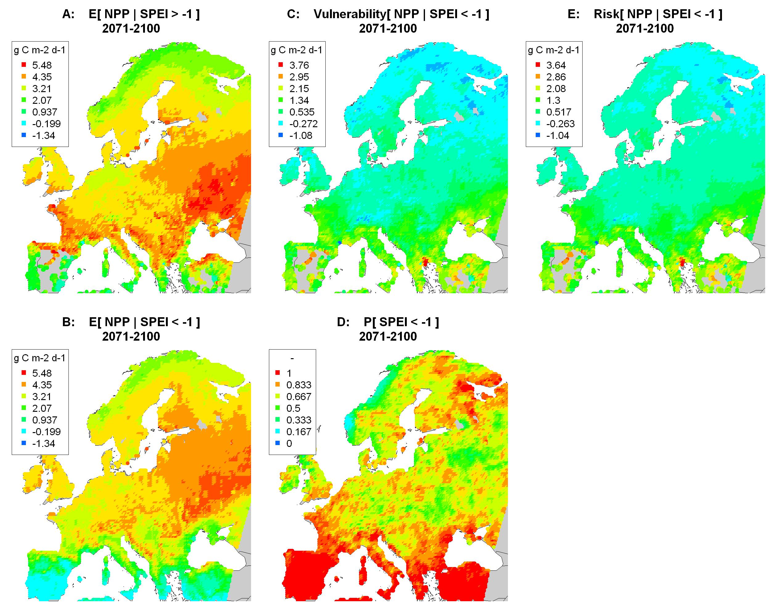
6.5 Drought-risk analysis for NPP in 2071-2100
Probability of drought (PH)
Risk (R)
= expectation of loss
R = P(H) V
Vulnerability (V)
Van Oijen et al. (2013, 2014)

Slide 78
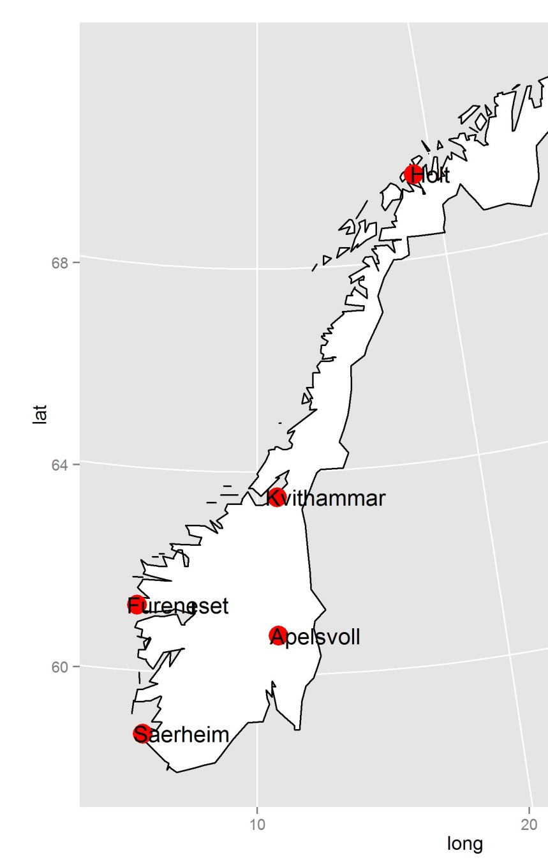
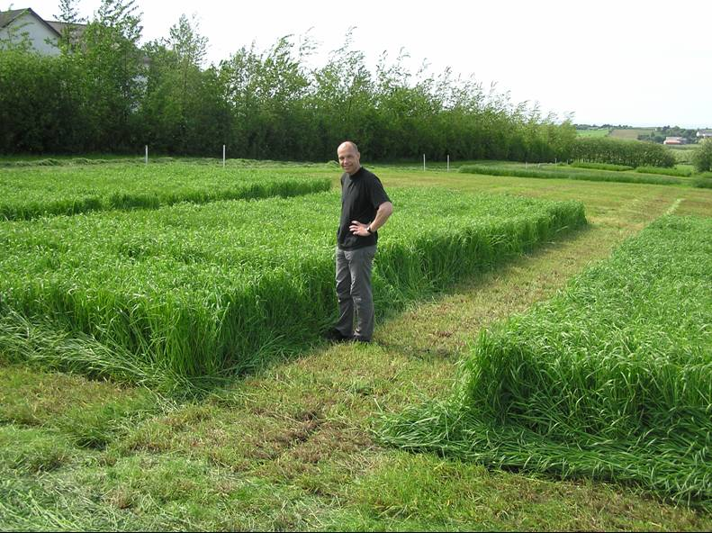
6.6 Bayesian ideotyping for plant breeding
Each circle represents a different simulated cultivar, i.e. a different parameter vector
Yield stability
(normalised)
Average yield
(normalised)
Van Oijen et al. (2016)

Slide 79
6.7 Intermediate-scale Bayes: Using LIDAR data
System: Corsican pine forest, U.K.
Data: Remote Sensing → {LAI, Height, Biomass}
RS-data:
Hyper-spectral, LiDAR, SAR
Bayesian calibration
Model 3-PG

Slide 80
6.8 Small-scale Bayes: BC instead of model spin-up
System: Grassland, Oensingen (Switzerland)
Model: DAYCENT
Data: Soil respiration
Data
Posterior
Prior

Slide 81
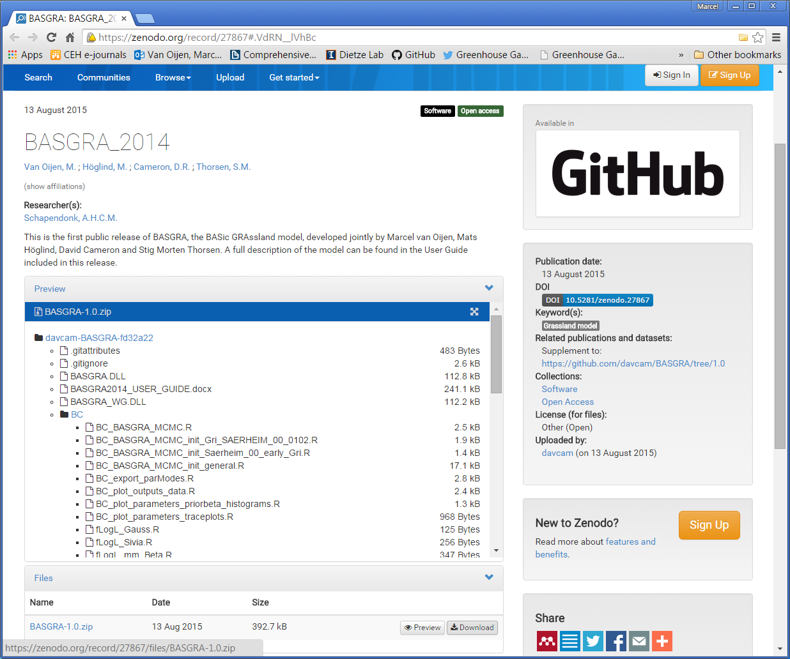
6.9 Download PBM plus code for BC / Troubleshooting MCMC
Van Oijen M, Höglind M, Cameron DR, Thorsen SM (2015). BASGRA_2014. http://dx.doi.org/10.5281/zenodo.27867
Van Oijen M (2008). Bayesian Calibration (BC) and Bayesian Model Comparison (BMC) of process-based models: Theory, implementation and guidelines. http://nora.nerc.ac.uk/6087/

Slide 82
7. Likelihood function L(θ) = P(D|θ)

Slide 83
7.1 How informative is my data set?
Data can be informative in two ways:
Having high precision (small S.D.)
Being numerous (large n)
Data can also be less informative than we thought …
Only stochastic measurement error considered
Measurements may be biased, e.g. taken in an ‘atypical’ forest (e.g. forest on polluted soil)
Measurements may not be at the ‘believable scale’ of the model
P(ϑ|D) = P(ϑ) P(D|ϑ) / P(D)

Slide 84
7.2 The most common likelihood function P(D|θ)
GAUSSIAN
Model-data mismatch for data-point i
P(D|ϑ) =
Measurement uncertainty for data-point i
MULTIPLICATION ⇔ information from different data-points considered uncorrelated

Slide 85
7.3 Decision tree for likelihood functions
Gaussian
SD same for all data
Stochastic
error
10 %
Non-Gaussian
CV same for all data
Not time-
averaged
20 %
30 d
Systematic
error
30 %
15 d
CV point-
specific
Time-
averaged
8 d
4 d
Points
Standard
deviation
DATA
Statistical
Moments
Variance
Patterns
Skewness
Within TS
Spectral
analysis
Across TS
Conserved ratios
Note: the diagram focuses on time-series data, but similar options exist for spatially distributed data

Slide 86
7.3 Decision tree for likelihood functions
Gaussian
SD same for all data
Stochastic
error
10 %
Non-Gaussian
CV same for all data
Not time-
averaged
20 %
30 d
Systematic
error
30 %
15 d
CV point-
specific
Time-
averaged
8 d
4 d
Points
Standard
deviation
DATA
Statistical
Moments
Variance
Patterns
Skewness
Within TS
Spectral
analysis
Across TS
Conserved ratios
Note: the diagram focuses on time-series data, but similar options exist for spatially distributed data

Slide 87
7.4 For data to be useful ...
... they must have a place in the likelihood function.
So they need to be relatable to model output.
Observational operators may be needed:
Scale change of output (e.g. spatial aggregation)
Transformation of output (e.g. allometry)
This allows all kinds of data to be used!

Slide 88
8. Summary

Slide 89
8.1 BC & BMC
1. Express all uncertainties probabilistically ⇒
Assign probability distributions to (1) data, (2) the collection of models, (3) the parameter-set of each individual model
2. Use the rules of probability theory to transfer the information from the data to the probability distributions for models and parameters
Main tool from probability theory to do this: Bayes’ Theorem
P(α|D) ∝ P(α) P(D|α)
Posterior is proportional to prior times likelihood
α = parameter set ⇒ parameterisation (“Bayesian Calibration”, BC)
α = model set ⇒ model evaluation (“Bayesian Model Comparison”, BMC)

Slide 90

8.2 Using environmental models: Uncertainties
Uncertainty in input maps and model parameter values
Uncertainty about model structure
BC, DA, MDF
General approach to uncertainty quantification and reduction:
Specify prior probability distributions
Get data
Determine posterior distributions
BMC, BMA

Slide 91
8.3 Bayesian methods in practice
Practicalities:
When new data arrive: MCMC provides a universal method for calculating posterior pdf’s
Easy to implement, difficult to fine-tune
Quantifying the prior:
Often not a big issue in env. sci.: (1) many data, (2) prior is posterior from previous calibration
Defining the likelihood:
Data that are given with +- stochastic error are NOT well-enough defined
Precision of measurement equipment (stochastic error) is far less important than data being unbiased and representative
For model development: BC & BMC are not enough !
Still a need for analysis of model-data mismatch
Overall: Uncertainty quantification often shows that our models are not very reliable

Slide 92
9. This week's course programme

Slide 93
Agenda
Date |  | What | Who | Software introduced
Every day | 9-9:15 | Coffee & Tea (Room 75)
 | 11-11:15 | Coffee & Tea (Room 75)
 | 13-14 | Lunch (Pentland Link) - not on Friday
 | 15:30-15:45 | Coffee & Tea (Room 75)
Mon 9 Sep. | 14-17 | Self-introductions by all, Bayesian basics, Overview of the course | MvO | R, Rstudio, Rmd
Tue 10 Sep. | 9:15-9:30 | Questions regarding yesterday? | MvO
 | 9:30-13 | Hierarchical modelling, Graphical modelling | KS | JAGS
 | 14-17 | Spatial modelling | LB | geoR
Wed 11 Sep. | 9:15-9:30 | Questions regarding yesterday? | KS & LB
 | 9:30-13 | Combining diverse datasets | PL | rstanarm
 | 14-17 | Comprehensive uncertainty quantification, Emulation | DC | Process-based modelling, BayesianTools
Thu 12 Sep. | 9:15-9:30 | Questions regarding yesterday? | PL & DC
 | 9:30-11 | Spatio-temporal modelling | LB | R-INLA
 | 11-13 | Model comparison & evaluation | MvO
 | 14-15 | Diagnosing model weaknesses | MvO
 | 15-17 | Communication of results | MvO | ggplot2 (PL), R-Shiny (DC)
Fri 13 Sep. | 9:15-9:30 | Questions regarding yesterday? | MvO
 | 9:30-13 | Software alternatives, Future use of Bayesian methodology, Group discussion | MvO

Slide 94
TUESDAY Morning: Hierarchical modelling, Graphical modelling

Slide 95
Graphical models (= probabilistic networks)
θ
θ
Unpooled model
…
y₁
y₂
y_{n}
…
y
y₁
y₂
y_{n}
…
Pooled model
b₁
b₂
b_{n}
P(θ|y) ∝
P(θ) P(y|θ)
P(θ|y) ∝ P(θ) P(y|θ) =
P(θ) P(y₁|θ) … P(y_{n}|θ)
P(b₁|y₁) ∝ P(b₁) P(y₁|b₁)
…
P(b_{n}|y_{n}) ∝ P(b_{n}) P(y_{n}|b_{n})
Black: Posterior
Red: Prior
Blue: Likelihood

Slide 96
Graphical models (= probabilistic networks)
θ
θ
…
…
y₁
y₂
y_{n}
y₁
y₂
y_{n}
…
…
b₁
b₂
b_{n}
b₁
b_{m}
Mixed model
Σ_{b}
P(θ,b|y) ∝
P(θ) x P(b₁) … P(b_{n}) x
P(y₁|θ,b₁) … P(y_{n}|θ,b_{n})
Hierarchical model
P(θ,b, Σ_{b}|y) ∝
P(θ) x P(b₁| Σ_{b}) … P(b_{m}| Σ_{b}) x
P(Σ_{b}) x
P(y₁|θ,b₁) … P(y_{n}|θ,b_{m})

Slide 97
Graphical models (= probabilistic networks)
θ
θ
…
y₁
y₂
y_{n}
y
n
…
b₁
b₂
b_{n}
b
m
Mixed model
P(θ,b|y) ∝
P(θ) x P(b₁) … P(b_{n}) x
P(y₁|θ,b₁) … P(y_{n}|θ,b_{n})
Σ_{b}
Hierarchical model
P(θ,b, Σ_{b}|y) ∝
P(θ) x P(b₁| Σ_{b}) … P(b_{m}| Σ_{b}) x
P(Σ_{b}) x
P(y₁|θ,b₁) … P(y_{n}|θ,b_{m})

Slide 98
Graphical models (= probabilistic networks)
X
y
DATA
μ
PROCESS
n
b
β
σ_{y}
PARAMETERS
m
Σ_{b}
HYPER-PARAMETERS

Slide 99
Clark (2006). Tree demographics

Slide 100
BHM for C-fluxes in grassland: JAGS code
Prior for initial constants
Croot[1] ~ dunif( 25, 75 )
Cshoot[1] ~ dunif( 0, 20 )
Cres[1] ~ dunif( 0, 20 )
for (i in 2:n) {
Croot[i] <- Croot[i-1] + Groot[i-1]
Cshoot[i] <- Cshoot[i-1] + Gshoot[i-1]
Cres[i] <- Cres[i-1] + S[i-1] }
for (i in 1:n) {
tau.P[i] <- pow( cv.P * P[i] , -2 )
tau.R[i] <- pow( cv.R * R[i] , -2 )
tau.LAI[i]<- pow( cv.LAI * LAI[i], -2 )
P.obs[i] ~ dnorm( P[i], tau.P[i] )
R.obs[i] ~ dnorm( R[i], tau.R[i] )
LAI.obs[i] ~ dnorm( LAI[i], tau.LAI[i] )
LAI[i] <- SLA * Cshoot[i]
P[i] <- Pmax * (1-exp(-0.7*LAI[i]))
rho[i] ~ dnorm( 0.5, .0001 )
alphamin[i] <- max( 1-4*rho[i], -Cres[i]/P[i] )
alpha[i] ~ dnorm( 0 , .01 ) T( alphamin[i], 1-rho[i] )
Rg[i] <- P[i] * ( 1/3 - rho[i]*1/3 - alpha[i]*1/3 )
Rm[i] <- P[i] * (-1/3 + rho[i]*4/3 + alpha[i]*1/3 )
R[i] <- Rg[i] + Rm[i]
S[i] <- P[i] * alpha[i]
G[i] <- P[i] * ( 1 - rho[i] - alpha[i] )
Groot[i] <- G[i] * fGroot
Gshoot[i] <- G[i] * (1-fGroot) }
cv.P ~ dunif( 0 , 1 )
cv.R ~ dunif( 0 , 1 )
cv.LAI ~ dunif( 0 , 1 )
SLA ~ dnorm( 0.02, 100 ) T( 0, )
Pmax ~ dunif( 5 , 30 )
fGroot ~ dunif( 0 , 1 )
State equations
Conditional distribution for data
LAI, P, ρ, α
Deterministic C-fluxes model
Prior for data and process parameters

Slide 101
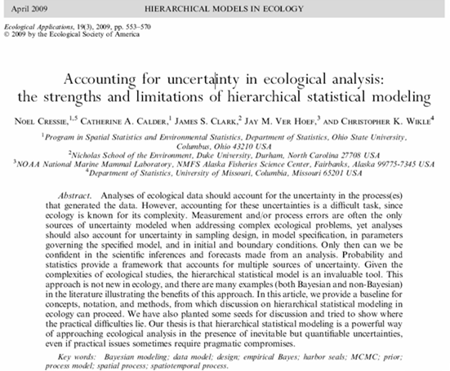
Hierarchical Bayesian modelling in ecology
Non-hierarchical
Hierarchical
ξ
P(ξ)
θ
θ_{i}
P(θ)
P(θ|ξ)
i=1..n
D
D
P(D|θ)
P(D|θ)
See also: Ogle, K. and J.J. Barber (2008) "Bayesian data-model integration in plant physiological and ecosystem ecology." Progress in Botany 69:281-311

Slide 102
TUESDAY Afternoon: Spatial modelling

Slide 103
Bayesian kriging
Variogram Mean field Sqrt( kriging
variance )

Slide 104
WEDNESDAY Morning: Combining diverse data sets

Slide 105
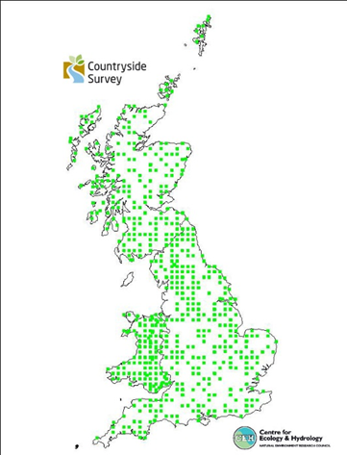
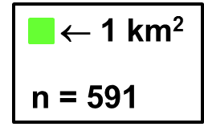
Land-use change
Remote Sensing
Field sampling
LCM2007 (Rowland et al. 2016)
CS2007 (Henrys et al. in prep.)

Slide 106
WEDNESDAY Afternoon: Comprehensive UQ, Emulation

Slide 107
Structural model error

Slide 108
THURSDAY Morning (1): Spatio-temporal modelling

Slide 109
Monitoring ecological & environmental processes

Slide 110
THURSDAY Morning (2): Model comparison & evaluation

Slide 111
8.1 BC & BMC
Bayes’ Theorem
P(α|D) ∝ P(α) P(D|α)
Posterior is proportional to prior times likelihood
α = parameter set ⇒ parameterisation (“Bayesian Calibration”, BC)
α = model set ⇒ model evaluation (“Bayesian Model Comparison”, BMC)

Slide 112

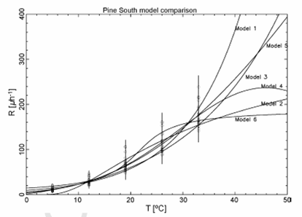
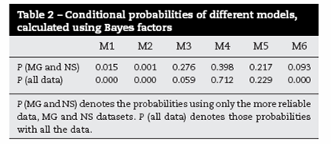
8.2 BMC: Tuomi et al. 2007

Slide 113
THURSDAY Afternoon (1): Diagnosing model weaknesses

Slide 114
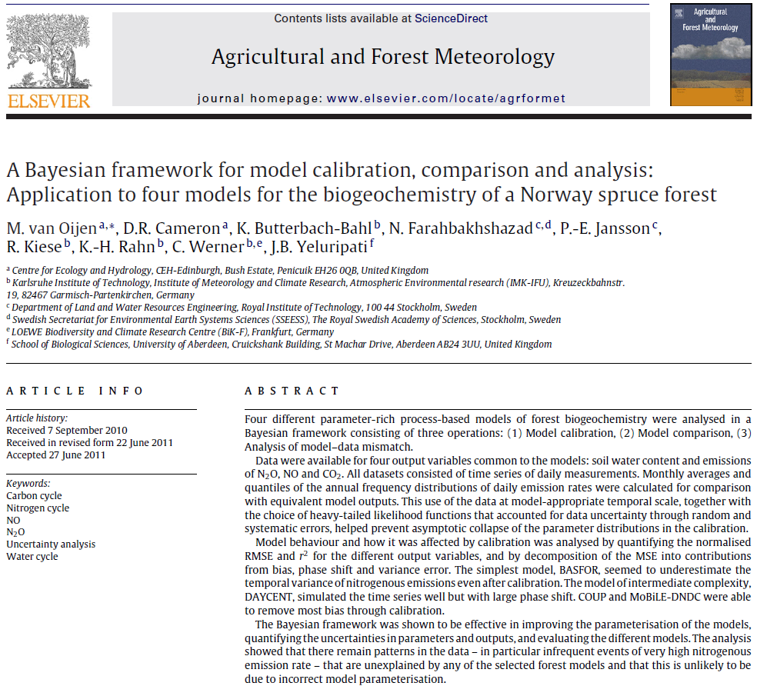
8.4 A three step-procedure

Slide 115
What can BC & BMC not do?
BC tells us about our parameters: what their values probably are
BMC tells us about the structure of our models: which model is more plausible than others.
But …
BC does not tell us why the most probable parameter values sometimes look strange
BMC does not tell us whether the most plausible model could be improved, or how.

Slide 116
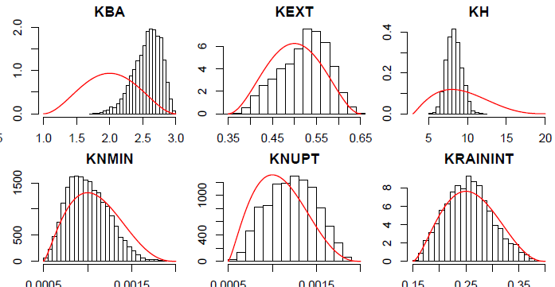
EXAMPLE: BC giving strange posterior pdf’s
Red lines: Prior pdf.
Black histograms: Posterior pdf after using data from Scots pine in Estonia.

Slide 117
THURSDAY Afternoon (2): Communication of results

Slide 118
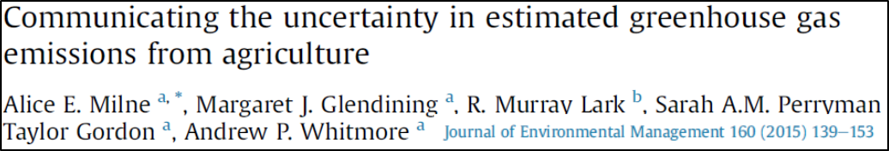
Milne et al. (2015)

Slide 119
FRIDAY Morning: Software alternatives, Future use of Bayes, Group discussion

Slide 120
Trends ?
Increasing use of hierarchical models (to represent complex prior pdf’s, to represent spatial relationships etc.)
Replacement of informal methods of model evaluation (or methods that only approximate the full probability approach) by BMC
Improvements in computational techniques for BC & BMC of slow process-based models
More use of probabilistic approaches in all areas of environmental science
Quantifying uncertainties
Risk analysis

Slide 121
10. Reading mathematical notation

Slide 122
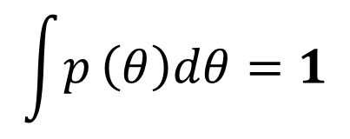
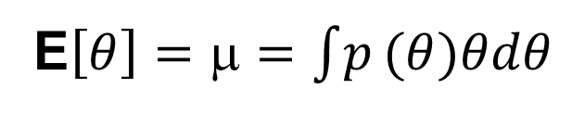

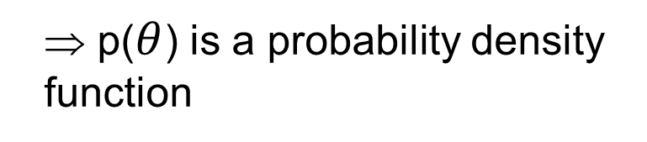
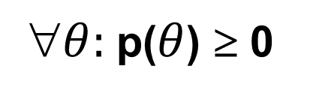
Probability distribution, Expectation, Variance
}
$θ:$p($θ$) ≥ 0
⇒ p($θ$) is a probability density function
$$\int{p}\left(θ\right)dθ=1$$
E$\left[θ\right]=μ=\int{p}(θ)θdθ$
Expectation value of $θ$ =
mean of distribution
Var$\left[θ\right]=E\left[\left(θ−μ\right)2\right]=σ2=\int{p}\left(θ\right)\left(θ−E\left[θ\right]\right)2dθ$
Variance of distribution

Slide 123
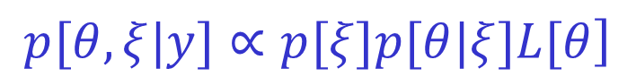
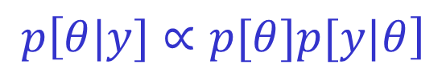
Bayes Theorem in different notation, and L(𝜃)
The value of p(y) is usually irrelevant:
$$p\left[θ|y]∝p[θ]p[y|θ\right]$$
Bayes' Theorem for hierarchical models:
$$\left.p[θ,ξ|y]∝p[ξ]p[θ|ξ]L[θ\right]$$
Square-bracket notation for probability distributions:
[θ|y] = [θ] [y|θ] / [y]
Gaussian Likelihood:
$$\left.p[y|θ]=N[y−f(x,θ);μ=0,σ^{2}=σ_{y}^{2}\right]$$

Slide 124
Matrix notation (ex: Gaussian distributions)
Prob. ↑
V^{1/2}
p(z) = (2πV)^{-1/2} Exp[-0.5(z-μ)V⁻¹(z- μ)]
μ
z →
p(z) = |2πΣ|^{-1/2} Exp[-0.5(z-μ)’Σ⁻¹(z-μ)]
Prob. ↑
z₁ →
z₁ →
z₀ →
z₀ →

